Slide 1
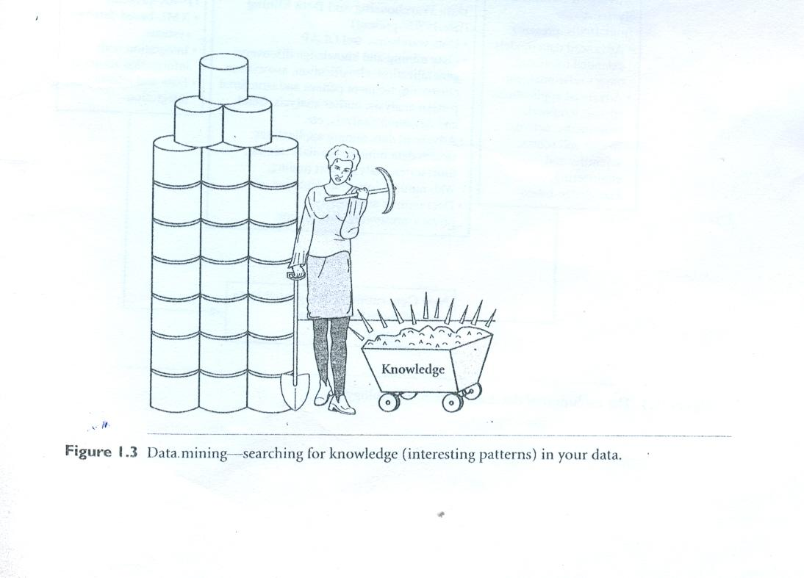
Data Mining

Slide 2
Why Data Mining?
Availability of huge amount of data
Necessity to convert the data into meaningful information Pattern Extraction from the large database
DM applies various techniques to data to extract pattern

Slide 3
Adv. Database Systems (mid 1980s – present)
    Object relation model
    Spatial, multimedia, scientific & Engineering database
Adv. Data Analysis(Data warehouse late 1980s)
Web based databases ( 1990s – present)
Leads to generation of Integrated Data and Information System

Slide 4
Evolution- Database Technology
DM - growth of Information Technology
Need to process data
1960s – File processing system
– Difficulty in FP leads to DB
1970s – early 1980s (DB)
    Different DB models
    Indexing and Accessing methods (B-trees, hashing)
    SQL, forms and reports
    OLTP

Slide 5
Data Collection and Database Creation
(1960s and Earlier)
primitive file processing
Database Management Systems (1970s – early 1980s)
Hierarchical and network database systems
Relational database systems
Data modeling tools: entity – relational models, etc
Indexing and accessing methods: B trees, hashing, etc.
Query languages: SQL, etc.
User interfaces, forms and reports
Query processing and query optimization
Transactions, concurrency control and recovery
On-line transaction processing (OLTP)
Advanced Database Systems
(mid- 1980s – present)
Advanced data models:
extended relational, object – relational, etc
Advanced applications:
spatial, temporal, multimedia, active, stream and sensor, scientific and engineering, knowledge based
Advanced Data Analysis:
Data warehousing and Data Mining
(late 1980s – present)
Data warehouse and OLAP
Data mining and knowledge discovery:
generalization, classification, association, clustering, frequent pattern and structured pattern analysis, outlier analysis, trend and deviation analysis, etc.
Advanced data mining applications: stream data mining, bio-data mining, time-series analysis, text mining, Web mining, intrusion detection, etc
Data mining and society:
privacy-preserving data mining
Web-based databases
(1990s- present)
XML- based db systems
Integration with information retrieval
Data and information integration
New Generation of Integrated Data and Information Systems
(present-future)

Slide 6
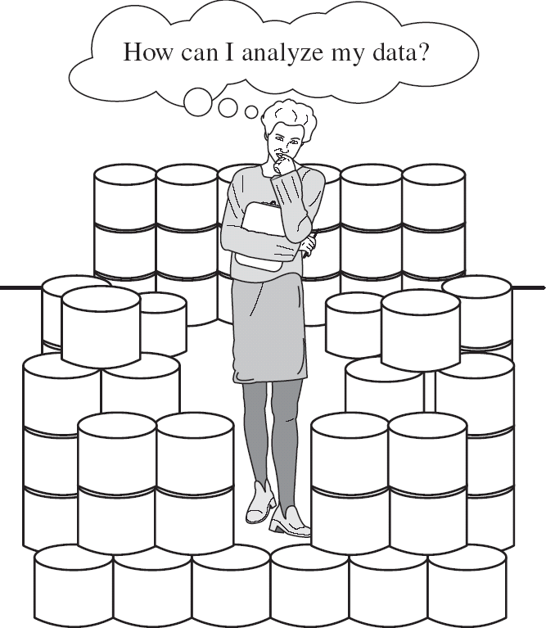
Data Rich, Information Poor

Slide 7
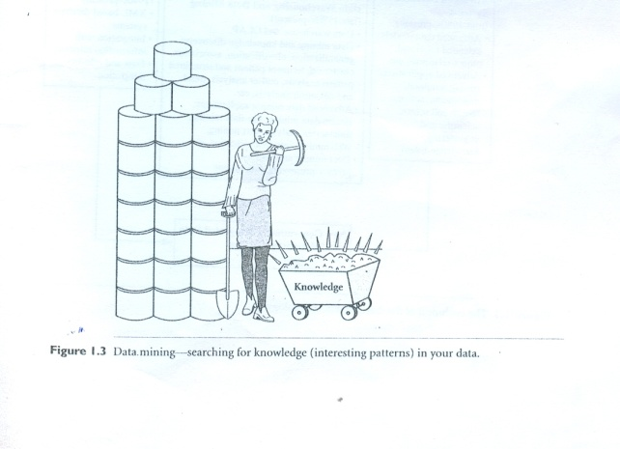
What is Data Mining ?
Find precious nuggets from a raw material
Extracting / Mining knowledge from data
  Pattern Extraction from the large data base
  What is pattern?
      Insights of data (Hidden uncovered pattern -similarity )
      Pattern - Knowledge
      Ex: Gold Mining

Slide 8
In other words…
Data mining (knowledge discovery from data)
  Extraction of interesting (non-trivial, implicit, previously unknown and potentially useful) patterns or knowledge from huge amount of data
Alternative names
  Knowledge mining from databases
  Knowledge extraction
  Data/pattern analysis
  Information harvesting
  Business intelligence
  Knowledge discovery (mining) in databases (KDD)

Slide 9
What kind of information are we collecting?
Non-exclusive list of a variety of information collected in digital form in databases and in flat files.
  Business transactions
  Scientific data: Medical and personal data
  Surveillance
  video and pictures
  Satellite sensing
  Games
  Digital media
  CAD and Software engineering data
  Virtual Worlds
  Text reports and memos (e-mail messages
  The World Wide Web repositories

Slide 10
Definitions
Knowledge
Information converted into knowledge about historical patterns and future trends.
For example
summary information on retail supermarket sales
can be analyzed in terms of
promotional efforts to provide knowledge of consumer buying behavior.
Manufacturer/retailer determine which items are most susceptible to promotional efforts.

Slide 11
Data Mining Applications
Data mining is highly useful in the following domains −
  Market Analysis and Management
  Corporate Analysis & Risk Management
  Fraud Detection
  Apart from these, data mining can also be used in the areas of production control, customer retention, science exploration, sports, astrology, and Internet Web Surf-Aid.

Slide 12
Data Mining Applications
  Market Analysis and Management
Customer Profiling − kind of people buy what kind of products
Identifying Customer Requirements − best products for different customers(factors attract new customers)
Cross Market Analysis − association/correlations between product sales
Target Marketing − clusters of model customers who share the same characteristics such as interests, spending habits, income, etc.
Determining Customer purchasing pattern − determining customer purchasing pattern
Providing Summary Information − multidimensional summary reports

Slide 13
Corporate Analysis and Risk Management
Finance Planning and Asset Evaluation - cash flow analysis and prediction,
contingent claim analysis to evaluate assets
Resource Planning − summarizing and comparing the resources and spending
Competition − monitoring competitors and market directions
Fraud Detection
Fields of credit card services and to detect fraud telephone calls
destination of the call, duration of the call, time of the day or week, etc.
patterns that deviate from expected norms

Slide 14
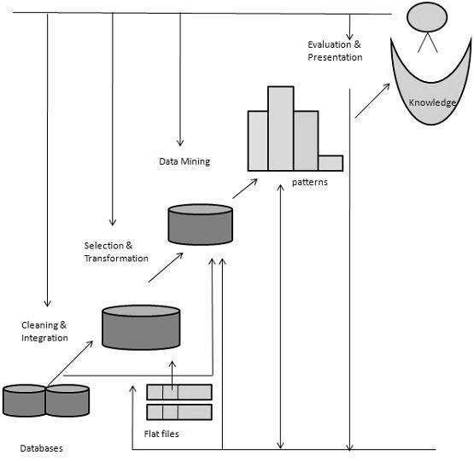
Data Mining in Knowledge Discovery Process

Slide 15
Knowledge discovery from data
KDD process includes
Data Cleaning (to remove noise and inconsistent data)
Data Integration (multiple data sources combined)
Data Selection (data relevant to the analysis task are retrieved from DB)
Data Transformation (data are transformed or consolidated
into forms appropriate for mining by performing
summary or aggregation operations)

Slide 16
KDD continued….
Data Mining (essential process-intelligent methods applied to
extract data patterns)
Pattern Evaluation (to identify truly interesting patterns
representing knowledge based on some
interestingness measures)
Knowledge Presentation (visualization and knowledge
representation techniques used to
present the mined knowledge to
user)

Slide 17
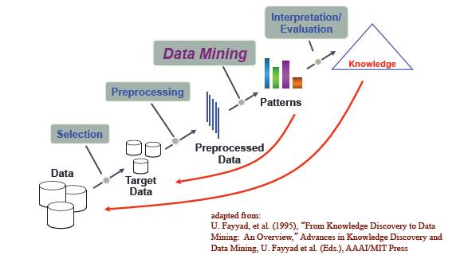
Knowledge Discovery (KDD) Process
  Data mining—core of knowledge discovery process

Slide 18
References
Data Mining in Bioinformatics, “Jason T.L. Wang”, “Mohammed J.Zaki”, “Hannu T.T.Toivonen”, “Dennis Shasha”.
Data Mining Concepts and Techniques, “Jiawei Han & Micheline Kamber”
Application of Data Mining in Bioinformatics, “Khalid Raza” , Indian Journal of Computer Science & Engineering

Slide 21
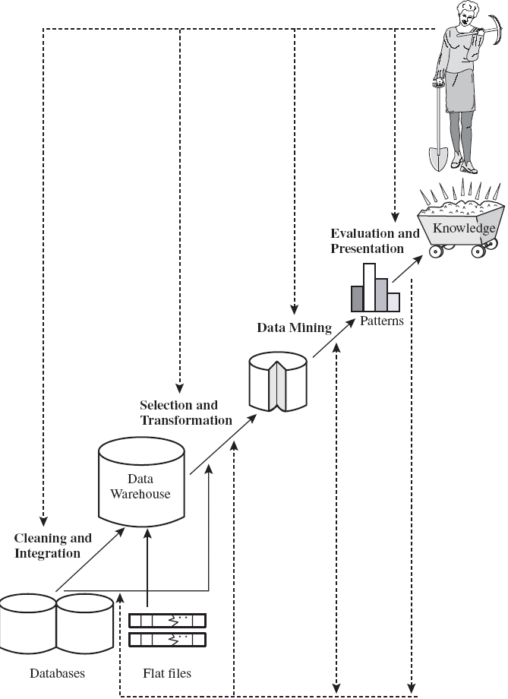
Data Mining in Knowledge Discovery Process

Slide 22
Application
Sales/Marketing (Buying patterns)
Banking ( credit card amount spend by the customer)
Insurance & Health care ( Identify the customers)
Medicine ( characterize patient behavior)
Biology

Slide 23
Biological Application
Sequence Analysis
Genome annotation
Analysis of gene, protein expression
Analysis of mutation in cancer
Protein structure prediction
Modeling biological systems
Protein-protein docking & so on.

Slide 24
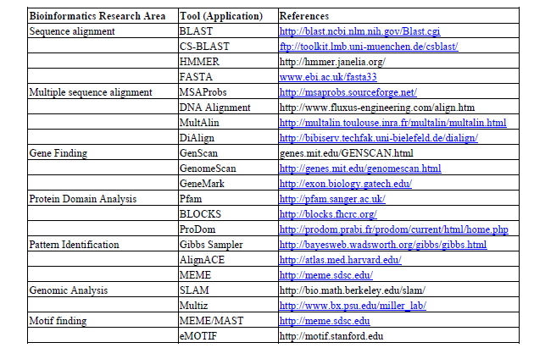
Some of the Biological DM tools

Slide 25
Knowledge Discovery (KDD) Process
  Data mining—core of knowledge discovery process
Knowledge
Pattern Evaluation
Data Mining
Task-relevant Data
Data Warehouse
Selection
Data Cleaning
Data Integration
Databases

